Slide 1
Using Lists and Tables
Session 3
(slot 4-5)

Slide 2
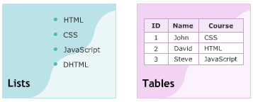
Objectives
Explain Ordered Lists.
Explain Unordered Lists.
Explain Description Lists.
Explain the Table elements.

Slide 3
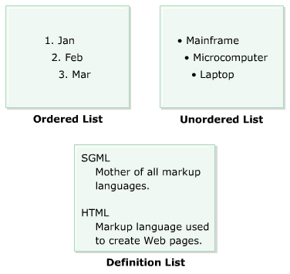
Lists
A List is a collection of items.
A list can contain other HTML elements such as image, links or other lists.

Slide 4
Ordered Lists
<HTML>
<HEAD>
<TITLE>Learning HTML</TITLE>
<BODY>
<H2>Days in a week</H2>
<OL>
<LI>Sunday
<LI>Monday
<LI>Tuesday
<LI>Wednesday
<LI>Thursday
<LI>Friday
<LI>Saturday
</OL>
</BODY>
</HTML>

Slide 5
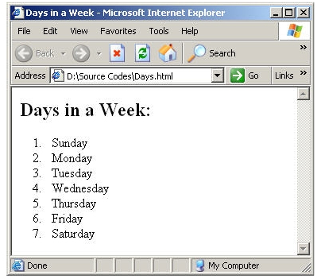
Ordered Lists

Slide 6
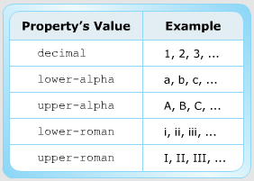
List-style-type
<OL STYLE="list-style-type:property’s value">

Slide 7
Nested Ordered lists
<HTML>
<HEAD><TITLE>Learning HTML</TITLE>
<BODY>
<H2>Web Designing with HTML</H2>
<OL>
<LI>Introduction to HTML
<OL STYLE="list-style-type:lower-roman">
<LI>WWW and Internet Overview
<LI>HTML Overview
<LI>Basic HTML Elements
</OL>
<LI>Working with HTML Elements
(continue…)

Slide 8
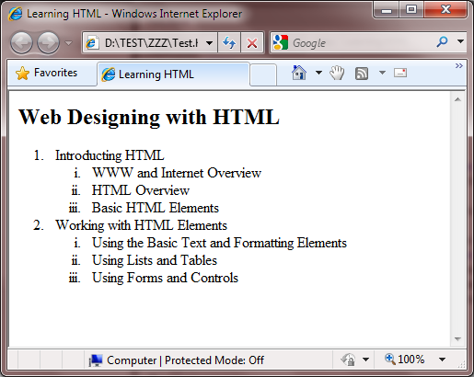
Nested Ordered lists

Slide 9
Unordered Lists
<HTML>
<HEAD>
<TITLE>Learning HTML</TITLE>
<BODY>
<H2>Wild Animals</H2>
<UL>
<LI>Lion
<LI>Tiger
<LI>Leopard
<LI>Wolf
</UL>
</BODY>
</HTML>

Slide 10
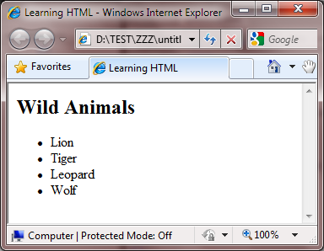
Unordered Lists

Slide 11
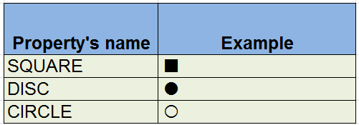
List-style-type
<OL STYLE="list-style-type:property’s value">

Slide 12
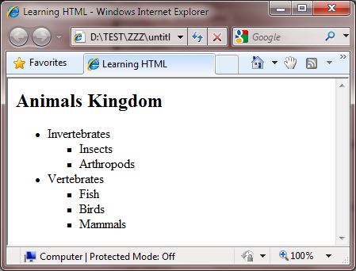
Nested Unordered lists

Slide 13
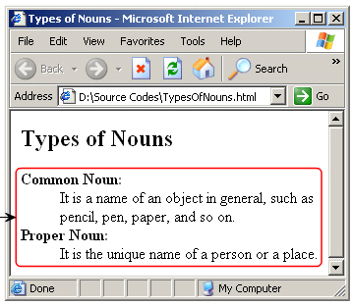
Description lists
DL
DT
DD

Slide 14
Unordered Lists
<HTML>
<HEAD>
<TITLE>Learning HTML</TITLE>
<BODY>
<H2>Types of noun</H2>
<DL>
<DT>Common noun
<DD>It is a name of an Object
in general such as pencil, pen
paper and so on
<DT>Proper noun
<DD>It is a unique name of a person
or a place
</DL>
</BODY>
</HTML>

Slide 15
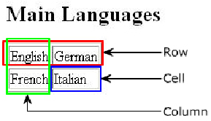
Tables
A table is made up of rows and columns.
The intersection of each row and column is a cell.
<THEAD>
<TBODY>
<TFOOT>
<TR>
<TH>
<TD>
<CAPTION>

Slide 16
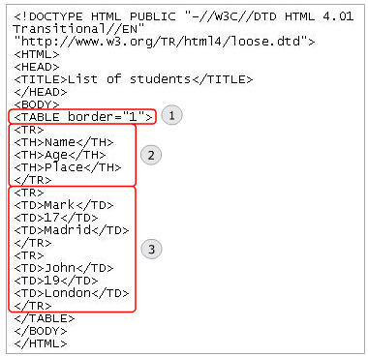
Columns heading

Slide 17
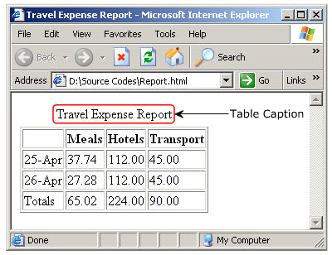
Caption

Slide 18
Colspan/Rowspan attribute
  These attributes are used to create cells that span more than one column or row.
  The COLSPAN attribute is used with the <TH> tag, while the ROWSPAN attribute is used with the <TD> tag.

Slide 19
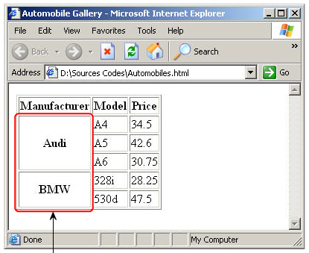
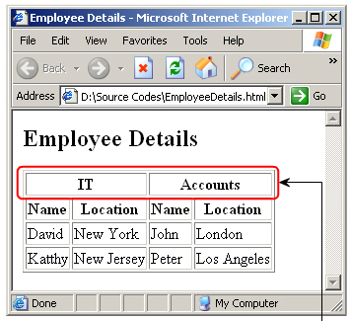
Colspan/Rowspan attribute
Rowspan
Colspan

Slide 20
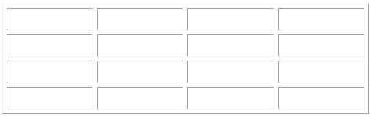
Some attribute
WIDTH
BORDER
CELLSPACING
CELLPADDING

Slide 21
Horizontal/Vertical alignment
<TD ALIGN = right VALIGN = bottom>
Data Cell 1</TD>
Align = left
Align = center
Align = right
Align = justify
Valign = top
Valign = middle
Valign = bottom
Valign = baseline
Not supported in HTML5, Aligns the content inside the <thead> element

Slide 22
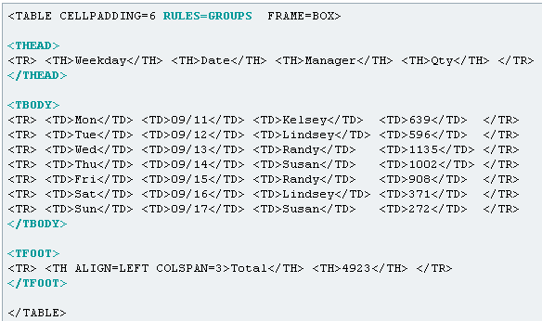
THEAD, TBODY,TFOOT ELEMENTS

Slide 23
Summary
A nested list refers to another list defined inside an item of a list.
The THEAD, TFOOT, TBODY elements allow grouping the rows in a table.
COLGROUP element allow grouping the column in a table.

Slide 24
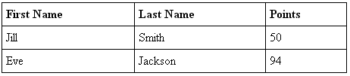

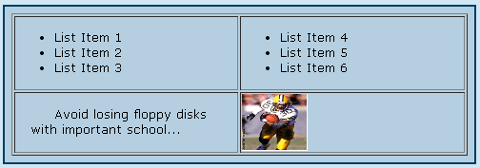
Exercise

